Slide 1
BITS Pilani presentation
K. Venkata Ratnam
Mathematics

Slide 2
Course Number : SS ZC416
Course Title: MATHEMATICAL FOUNDATIONS
FOR DATA SCIENCE
Lecture No. :3

Slide 3
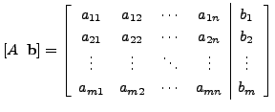
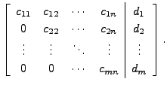
Gauss elimination procedure
Gaussian elimination is a method of solving a linear system (consisting of equations in unknowns) by bringing the augmented matrix to an upper triangular form.
Step 1: Given Ax=b;
Step 2: Prepare the augmented matrix :
Step 3 : Reduce the matrix to Row Echelon Form by using row operations only then it will turn to upper triangular matrix :
Step4: Use backward substitution (start with last nonzero row) to get the solution.

Slide 4
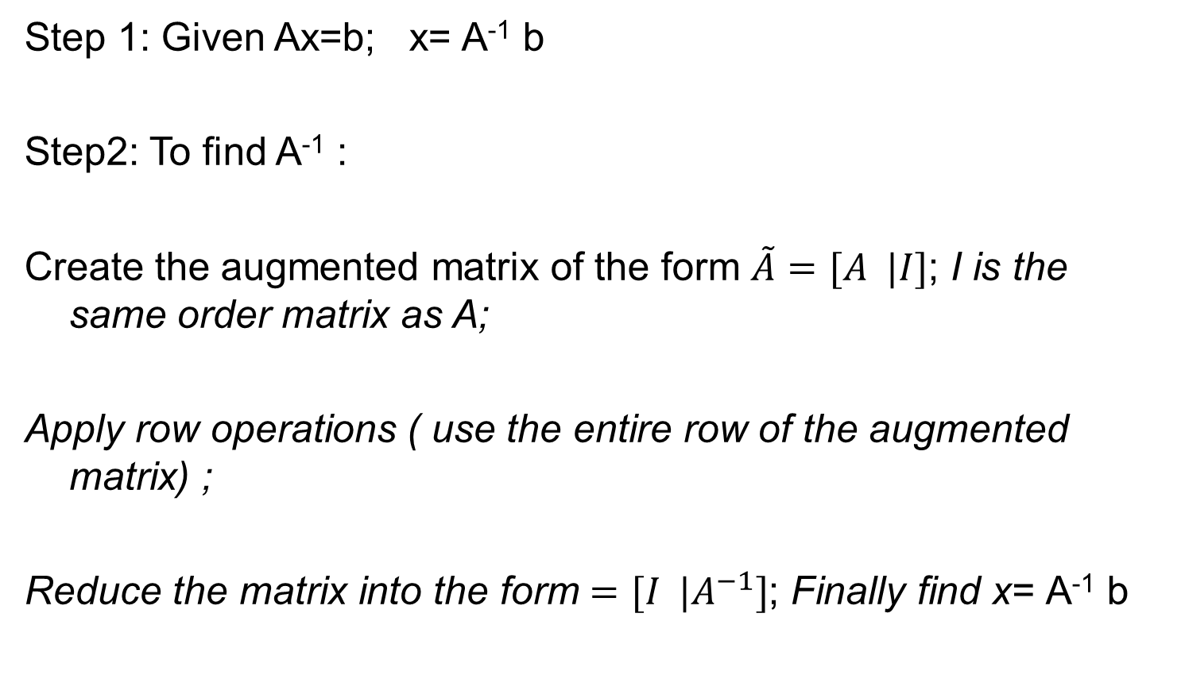
Gauss Jordan method
Step 1: Given Ax=b; x= A⁻¹ b
Step2: To find A⁻¹ :
Create the augmented matrix of the form $\tilde{A}=[A |I]$; I is the same order matrix as A;
Apply row operations ( use the entire row of the augmented matrix) ;
Reduce the matrix into the form $=[I |A^{−1}]$; Finally find x= A⁻¹ b

Slide 5
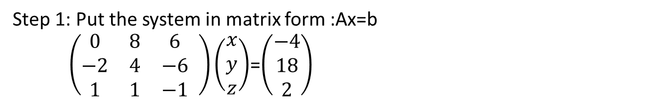
Gauss elimination method:
Unique solution
Solve the following system by gauss elimination method and gauss Jordan method.
8y+6z=-4
-2x+4y-6z=18
x+y-z=2.
Step 1: Put the system in matrix form :Ax=b
$\left(\begin{matrix}0 & 8 & 6 \\ −2 & 4 & −6 \\ 1 & 1 & −1\end{matrix} \right)\left(\begin{matrix}x \\ y \\ z\end{matrix}\right)$=$\left(\begin{matrix}−4 \\ 18 \\ 2\end{matrix}\right)$
Step 2: Write the augmented matrix : $\tilde{A}=[A |b]$;

Slide 6


solution
$$\tilde{A}=[A |b]=\left(\begin{matrix}0 & 8 & 6 \\ −2 & 4 & −6 \\ 1 & 1 & −1\end{matrix}\begin{matrix} −4 \\ 18 \\ 2\end{matrix}\right)$$
Step3 : Apply row operations and reduce the matrix into Row Reduced Echelon Form $:$
$$R13\left(\begin{matrix}1 & 1 & −1 \\ −2 & 4 & −6 \\ 0 & 8 & 6\end{matrix}\begin{matrix} 2 \\ 18 \\ −4\end{matrix}\right)$$
$R21\left(2\right), R2 (\frac{1}{6}) \left(\begin{matrix}1 & 1 & −1 \\ 0 & 1 & −4/3 \\ 0 & 8 & 6\end{matrix}\begin{matrix} 2 \\ 11/3 \\ −4\end{matrix}\right)$
R₃₂ (-8) $\left(\begin{matrix}1 & 1 & −1 \\ 0 & 1 & −4/3 \\ 0 & 0 & 50/3\end{matrix}\begin{matrix} 2 \\ 11/3 \\ −100/3\end{matrix}\right) R3(\frac{3}{50})$ :$\left(\begin{matrix}1 & 1 & −1 \\ 0 & 1 & −4/3 \\ 0 & 0 & 1\end{matrix}\begin{matrix} 2 \\ 11/3 \\ −2\end{matrix}\right)$

Slide 7
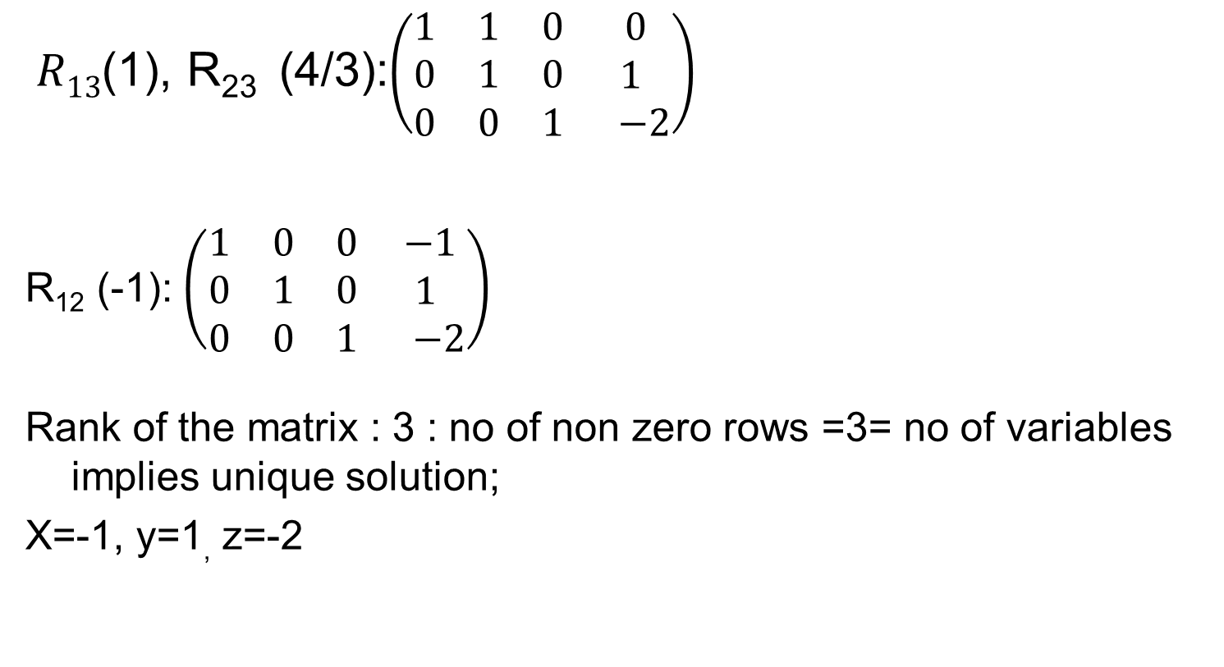
Solution
$R13$(1), R₂₃ (4/3):$\left(\begin{matrix}1 & 1 & 0 \\ 0 & 1 & 0 \\ 0 & 0 & 1\end{matrix}\begin{matrix} 0 \\ 1 \\ −2\end{matrix}\right)$
R₁₂ (-1): $\left(\begin{matrix}1 & 0 & 0 \\ 0 & 1 & 0 \\ 0 & 0 & 1\end{matrix}\begin{matrix} −1 \\ 1 \\ −2\end{matrix}\right)$
Rank of the matrix : 3 : no of non zero rows =3= no of variables implies unique solution;
X=-1, y=1, z=-2

Slide 8
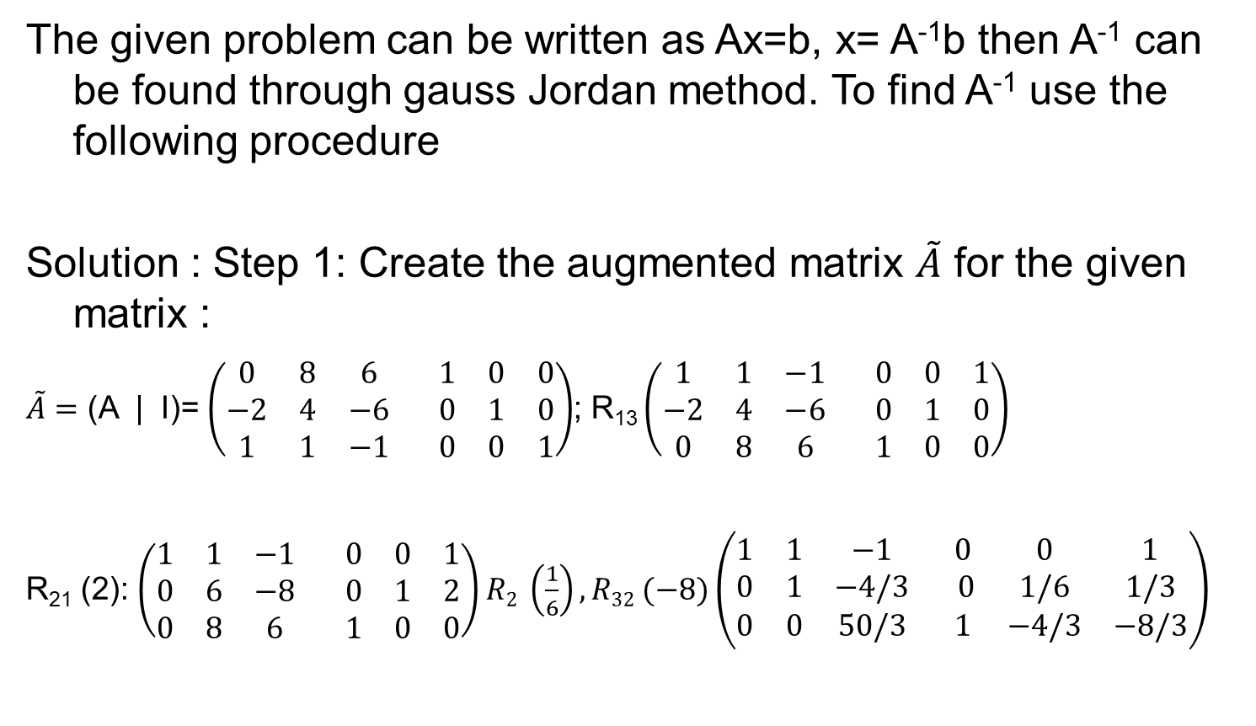
Gauss Jordan method:
The given problem can be written as Ax=b, x= A⁻¹b then A⁻¹ can be found through gauss Jordan method. To find A⁻¹ use the following procedure
Solution : Step 1: Create the augmented matrix $\tilde{A}$ for the given matrix :
$\tilde{A}=$ (A | I)= $\left(\begin{matrix}0 & 8 & 6 \\ −2 & 4 & −6 \\ 1 & 1 & −1\end{matrix} \begin{matrix}1 & 0 & 0 \\ 0 & 1 & 0 \\ 0 & 0 & 1\end{matrix}\right)$; R₁₃ $\left(\begin{matrix}1 & 1 & −1 \\ −2 & 4 & −6 \\ 0 & 8 & 6\end{matrix} \begin{matrix}0 & 0 & 1 \\ 0 & 1 & 0 \\ 1 & 0 & 0\end{matrix}\right)$
R₂₁ (2): $\left(\begin{matrix}1 & 1 & −1 \\ 0 & 6 & −8 \\ 0 & 8 & 6\end{matrix} \begin{matrix}0 & 0 & 1 \\ 0 & 1 & 2 \\ 1 & 0 & 0\end{matrix}\right)$ $R2 \left(\frac{1}{6}\right), R32 (−8)\left(\begin{matrix}1 & 1 & −1 \\ 0 & 1 & −4/3 \\ 0 & 0 & 50/3\end{matrix} \begin{matrix}0 & 0 & 1 \\ 0 & 1/6 & 1/3 \\ 1 & −4/3 & −8/3\end{matrix}\right)$

Slide 9
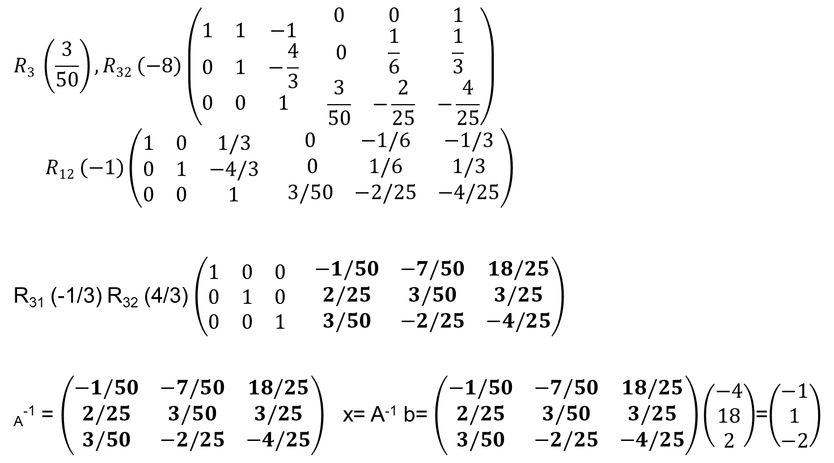
Soluiton
$$R3 \left(\frac{3}{50}\right), R32 \left(−8\right)\left(\begin{matrix}1 & 1 & −1 \\ 0 & 1 & −\frac{4}{3} \\ 0 & 0 & 1\end{matrix} \begin{matrix}0 & 0 & 1 \\ 0 & \frac{1}{6} & \frac{1}{3} \\ \frac{3}{50} & −\frac{2}{25} & −\frac{4}{25}\end{matrix}\right)$$
$$R12 \left(−1\right)\left(\begin{matrix}1 & 0 & 1/3 \\ 0 & 1 & −4/3 \\ 0 & 0 & 1\end{matrix} \begin{matrix}0 & −1/6 & −1/3 \\ 0 & 1/6 & 1/3 \\ 3/50 & −2/25 & −4/25\end{matrix}\right)$$
R₃₁ (-1/3) R₃₂ (4/3) $\left(\begin{matrix}1 & 0 & 0 \\ 0 & 1 & 0 \\ 0 & 0 & 1\end{matrix} \begin{matrix}−1/50 & −7/50 & 18/25 \\ 2/25 & 3/50 & 3/25 \\ 3/50 & −2/25 & −4/25\end{matrix}\right)$
_{A}⁻¹ = $\left(\begin{matrix}−1/50 & −7/50 & 18/25 \\ 2/25 & 3/50 & 3/25 \\ 3/50 & −2/25 & −4/25\end{matrix}\right)$ x= A⁻¹ b= $\left(\begin{matrix}−1/50 & −7/50 & 18/25 \\ 2/25 & 3/50 & 3/25 \\ 3/50 & −2/25 & −4/25\end{matrix}\right)\left(\begin{matrix}−4 \\ 18 \\ 2\end{matrix}\right)$=$\left(\begin{matrix}−1 \\ 1 \\ −2\end{matrix}\right)$

Slide 10
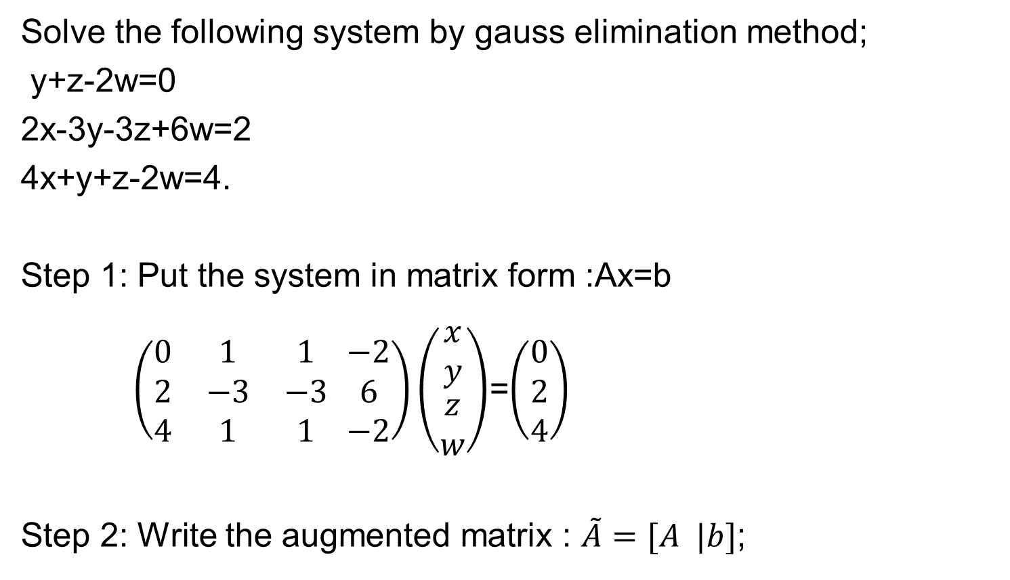
Problem: Gauss Elimination:
Infinite solutions
Solve the following system by gauss elimination method;
y+z-2w=0
2x-3y-3z+6w=2
4x+y+z-2w=4.
Step 1: Put the system in matrix form :Ax=b
$\left(\begin{matrix}0 & 1 & 1 \\ 2 & −3 & −3 \\ 4 & 1 & 1\end{matrix} \begin{matrix}−2 \\ 6 \\ −2\end{matrix}\right)\left(\begin{matrix}x \\ y \\ \begin{aligned}z \\ w\end{aligned}\end{matrix}\right)$=$\left(\begin{matrix}0 \\ 2 \\ 4\end{matrix}\right)$
Step 2: Write the augmented matrix : $\tilde{A}=[A |b]$;

Slide 11
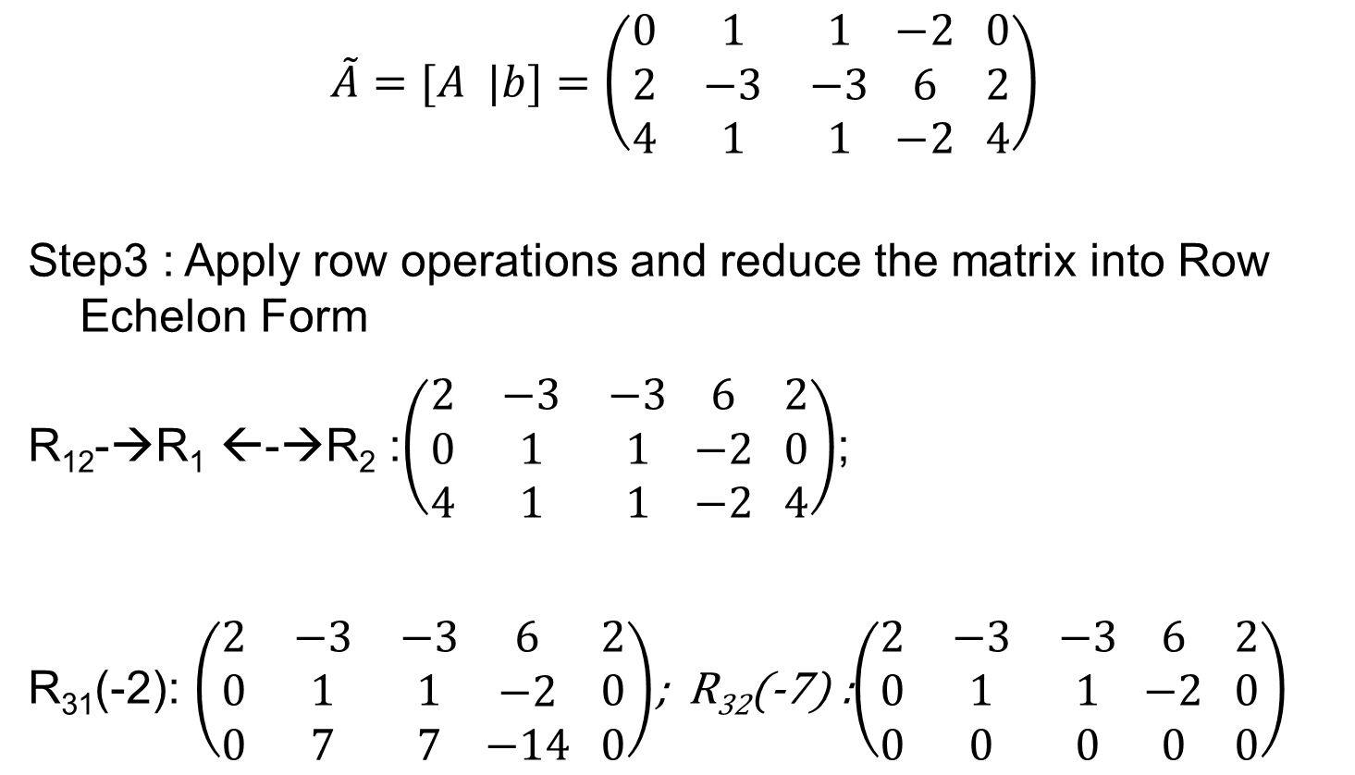
Cont…
$$\tilde{A}=[A |b]=\left(\begin{matrix}0 & 1 & 1 \\ 2 & −3 & −3 \\ 4 & 1 & 1\end{matrix} \begin{matrix}−2 \\ 6 \\ −2\end{matrix} \begin{matrix}0 \\ 2 \\ 4\end{matrix}\right)$$
Step3 : Apply row operations and reduce the matrix into Row Echelon Form
R₁₂-→R₁ ←-→R₂ :$\left(\begin{matrix}2 & −3 & −3 \\ 0 & 1 & 1 \\ 4 & 1 & 1\end{matrix} \begin{matrix}6 \\ −2 \\ −2\end{matrix} \begin{matrix}2 \\ 0 \\ 4\end{matrix}\right)$;
R₃₁(-2): $\left(\begin{matrix}2 & −3 & −3 \\ 0 & 1 & 1 \\ 0 & 7 & 7\end{matrix} \begin{matrix}6 \\ −2 \\ −14\end{matrix} \begin{matrix}2 \\ 0 \\ 0\end{matrix}\right)$; R₃₂(-7) :$\left(\begin{matrix}2 & −3 & −3 \\ 0 & 1 & 1 \\ 0 & 0 & 0\end{matrix} \begin{matrix}6 \\ −2 \\ 0\end{matrix} \begin{matrix}2 \\ 0 \\ 0\end{matrix}\right)$

Slide 12
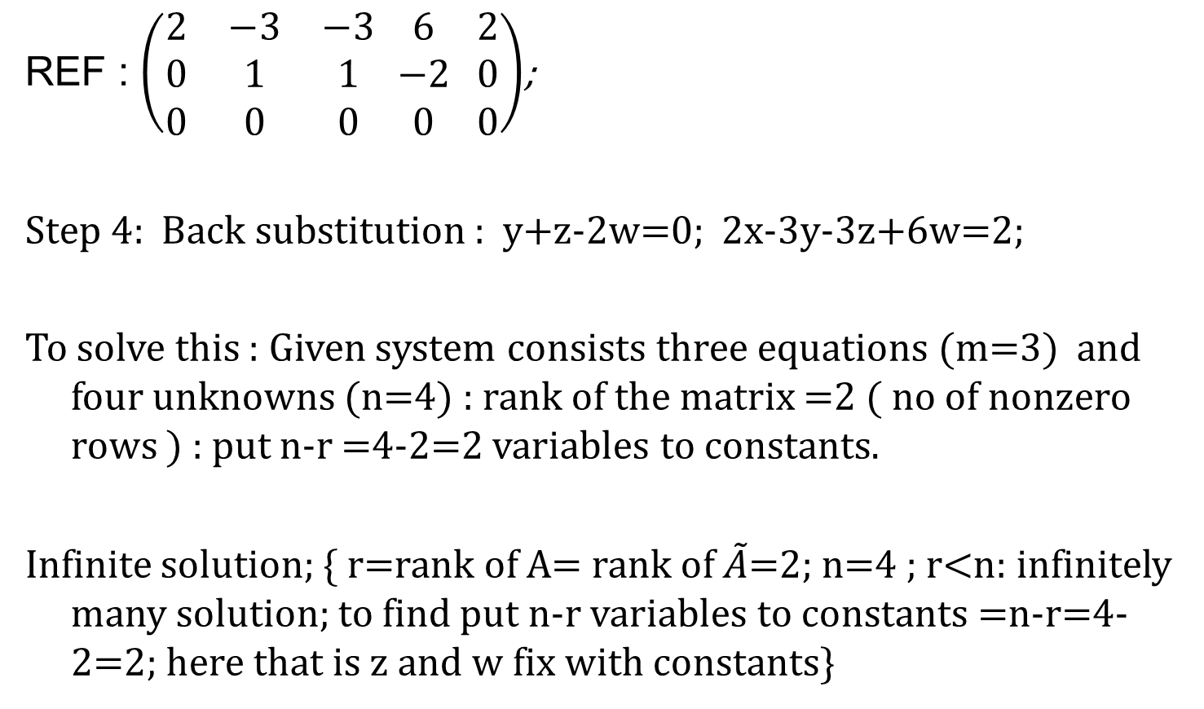
Cont..
REF : $\left(\begin{matrix}2 & −3 & −3 \\ 0 & 1 & 1 \\ 0 & 0 & 0\end{matrix} \begin{matrix}6 \\ −2 \\ 0\end{matrix} \begin{matrix}2 \\ 0 \\ 0\end{matrix}\right)$;
Step 4: Back substitution : y+z-2w=0; 2x-3y-3z+6w=2;
To solve this : Given system consists three equations (m=3) and four unknowns (n=4) : rank of the matrix =2 ( no of nonzero rows ) : put n-r =4-2=2 variables to constants.
Infinite solution; { r=rank of A= rank of $\tilde{A}$=2; n=4 ; r<n: infinitely many solution; to find put n-r variables to constants =n-r=4-2=2; here that is z and w fix with constants}

Slide 13
Cont..
That is generally last two variable are constant( any value) say z= s, w=t
then y=-s+2w=-s+2t;
2x=2+3y+3s-6w=2-3s+6t+3s-6t;
2x=2; x=1; y=-s+2t;
One solution is x=1, y=1, z=1, w=1 by keeping s=1 and t=1

Slide 14
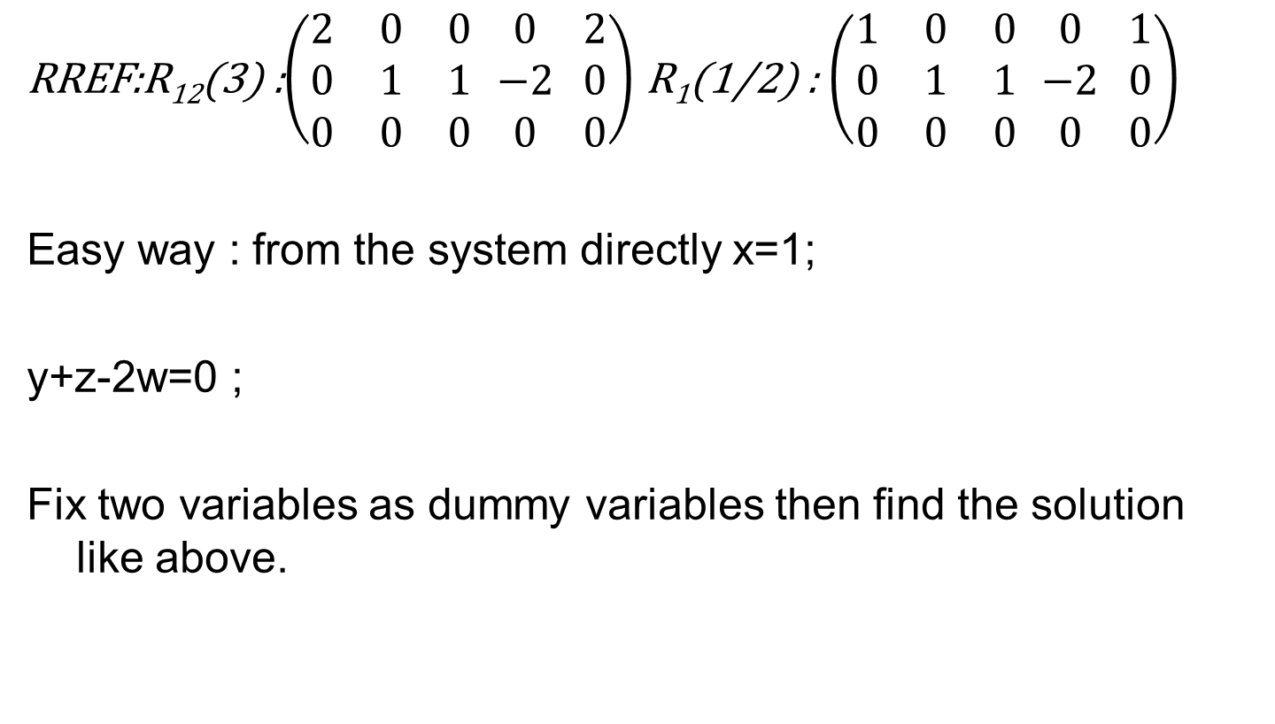
Cont…
RREF:R₁₂(3) :$\left(\begin{matrix}2 & 0 & 0 \\ 0 & 1 & 1 \\ 0 & 0 & 0\end{matrix} \begin{matrix}0 \\ −2 \\ 0\end{matrix} \begin{matrix}2 \\ 0 \\ 0\end{matrix}\right)$ R₁(1/2) : $\left(\begin{matrix}1 & 0 & 0 \\ 0 & 1 & 1 \\ 0 & 0 & 0\end{matrix} \begin{matrix}0 \\ −2 \\ 0\end{matrix} \begin{matrix}1 \\ 0 \\ 0\end{matrix}\right)$
Easy way : from the system directly x=1;
y+z-2w=0 ;
Fix two variables as dummy variables then find the solution like above.

Slide 15
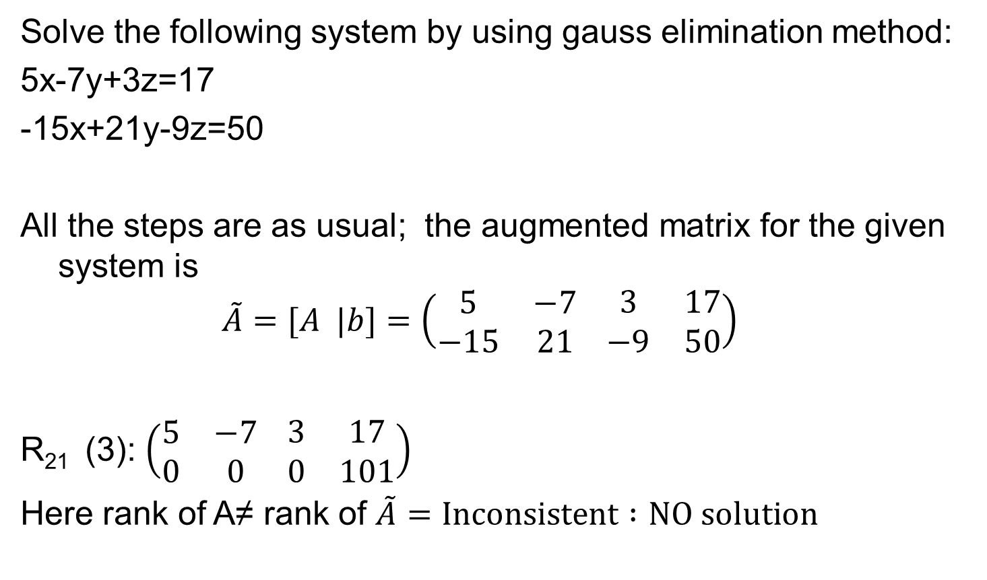
No solution
Solve the following system by using gauss elimination method:
5x-7y+3z=17
-15x+21y-9z=50
All the steps are as usual; the augmented matrix for the given system is
$$\tilde{A}=[A |b]=\left(\begin{matrix}5 & −7 \\ −15 & 21\end{matrix} \begin{matrix}3 & 17 \\ −9 & 50\end{matrix}\right)$$
R₂₁ (3): $\left(\begin{matrix}5 & −7 \\ 0 & 0\end{matrix} \begin{matrix}3 & 17 \\ 0 & 101\end{matrix}\right)$
Here rank of A≠ rank of $\tilde{A}=Inconsistent :NO solution$

Slide 16

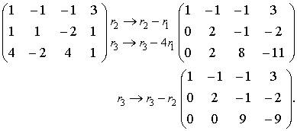
Problem
Use Gaussian elimination to solve the following homogeneous system of equations.
By elementary transformations, the coefficient matrix can be reduced to the row echelon form

Slide 17

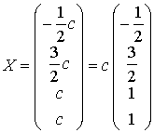
The rank of this matrix equals r=3, and so the system with four unknowns (n-r=4-3=1) has an infinite number of solutions, depending on one free variable. If we choose x₄ as the free variable and set x₄=c, then the leading unknowns have to be expressed through the parameter c. The above matrix corresponds to the following homogeneous system

Slide 18
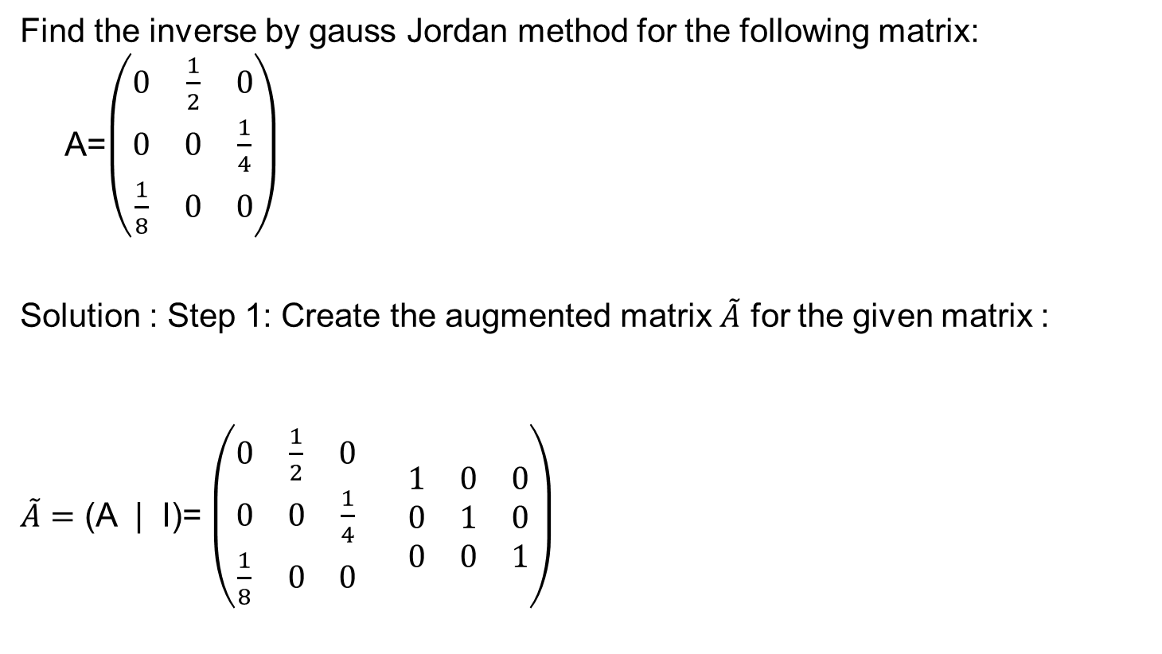
Problem
(Gauss Jordan )
Find the inverse by gauss Jordan method for the following matrix: A=$\left(\begin{matrix}0 & \frac{1}{2} & 0 \\ 0 & 0 & \frac{1}{4} \\ \frac{1}{8} & 0 & 0\end{matrix}\right)$
Solution : Step 1: Create the augmented matrix $\tilde{A}$ for the given matrix :
$\tilde{A}=$ (A | I)= $\left(\begin{matrix}0 & \frac{1}{2} & 0 \\ 0 & 0 & \frac{1}{4} \\ \frac{1}{8} & 0 & 0\end{matrix} \begin{matrix}1 & 0 & 0 \\ 0 & 1 & 0 \\ 0 & 0 & 1\end{matrix}\right)$

Slide 19
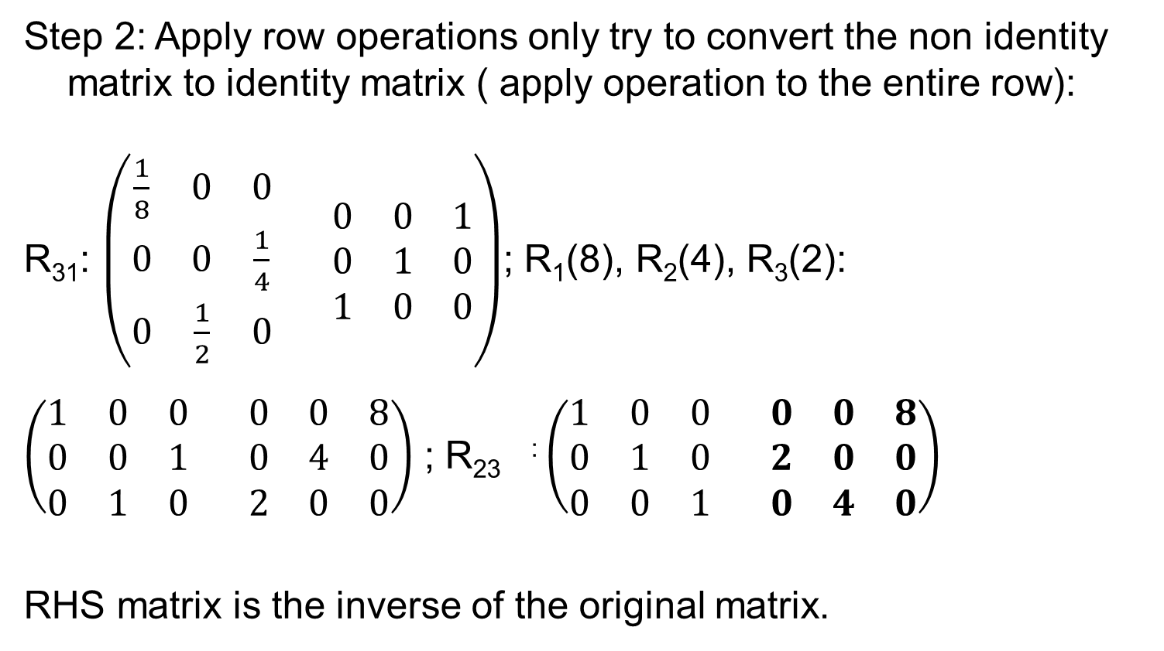
Cont..
Step 2: Apply row operations only try to convert the non identity matrix to identity matrix ( apply operation to the entire row):
R₃₁: $\left(\begin{matrix}\frac{1}{8} & 0 & 0 \\ 0 & 0 & \frac{1}{4} \\ 0 & \frac{1}{2} & 0\end{matrix} \begin{matrix}0 & 0 & 1 \\ 0 & 1 & 0 \\ 1 & 0 & 0\end{matrix}\right)$; R₁(8), R₂(4), R₃(2):
$\left(\begin{matrix}1 & 0 & 0 \\ 0 & 0 & 1 \\ 0 & 1 & 0\end{matrix} \begin{matrix}0 & 0 & 8 \\ 0 & 4 & 0 \\ 2 & 0 & 0\end{matrix}\right)$ ; R₂₃ : $\left(\begin{matrix}1 & 0 & 0 \\ 0 & 1 & 0 \\ 0 & 0 & 1\end{matrix} \begin{matrix}0 & 0 & 8 \\ 2 & 0 & 0 \\ 0 & 4 & 0\end{matrix}\right)$
RHS matrix is the inverse of the original matrix.

Slide 20
Practice problems
Solve the system using gauss elimination method:
10x+4y-2z=14
-3w-15x+y+2z=0
w+x+y=6
8w-5x+5y-10z=26;
Solution : 1 0 0 0 0
0 1 0 0 4
0 0 1 0 1
0 0 0 1 2

Slide 21

Problem
Find the inverse by gauss-Jordon :
$$\left(\begin{matrix}−4 & 0 & 0 \\ 0 & 8 & 13 \\ 0 & 3 & 5\end{matrix} \right)$$
Prove that (A⁻¹)⁻¹=A

Slide 22
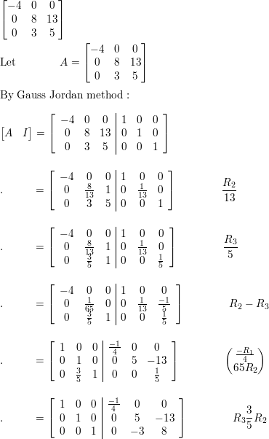

Slide 23
Todays Lecture
Vector spaces and Linear transformations
Vector space
Subspace
Linear dependence and independence
Span of a set
Basis and dimension
Linear transformation, rank and nullity

Slide 24
Notations:
Vectors in R^{n} : An ordered n-tuple: a sequence of n real numbers
R^{n}-space: the set of all ordered n-tuples
R¹-space = set of all real numbers (R¹-space can be represented geometrically by the x-axis)
R²-space = set of all ordered pair of real numbers
(R²-space can be represented geometrically by the xy-plane)
R³-space = set of all ordered triple of real numbers
(R³-space can be represented geometrically by the xyz-space)
R⁴-space = set of all ordered quadruple of real numbers

Slide 25
Vector Space
Real Vector Space
A nonempty set V of elements a, b, • • • is called a real vector space (or real linear space), and these elements are called vectors (regardless of their nature, which will come out from the context or will be left arbitrary) if, in V, there are defined two algebraic operations (called vector addition and scalar multiplication) as follows.
Vector addition associates with every pair of vectors a and b of V a unique vector of V, called the sum of a and b and denoted by a + b, such that the following axioms are satisfied.

Slide 26
Vector addition
I.1 Commutativity. For any two vectors a and b of V,
a + b = b + a.
I.2 Associativity. For any three vectors a, b, c of V,
(a+ b)+c = a +(b + c) (written a + b + c).
I.3 There is a unique vector in V, called the zero vector and denoted by 0, such that for every a in V,
a + 0= a.
I.4 For every a in V there is a unique vector in V that is denoted by -a and is such that
a + (-a) 0.

Slide 27
Scalar Multiplication
II. Scalar multiplication. The real numbers are called scalars. Scalar multiplication associates with every a in V and every scalar c a unique vector of V, called the product of c and a and denoted by ca (or ac) such that the following axioms are satisfied.
II.1 Distributivity. For every scalar c and vectors a and b in V, c(a + b) = ca + cb.
II.2 Distributivity. For all scalars c and k and every a in V,
(c + k)a = ca + ka.
II.3 Associativity. For all scalars c and k and every a in V,
c(ka) = (ck)a (written cka).
II.4 For every a in V, 1a = a.

Slide 28
Subspace
A subspace (W) of a vector space V we mean a nonempty subset of V (including V itself) that forms a vector space with respect to the two algebraic operations (addition and scalar multiplication) defined for the vectors of V.

Slide 29
Linearly Independent
Given any set of m vectors a₁,a₂, …a_{n,} (with the same number of components), a linear combination of these vectors is an expression of the form c₁ a₁+ c₂ a₂+ … c_{n} a_{n}
where c₁ , c₂ , …, c_{n} are any scalars. Now consider the equation
(1) c₁ a₁+ c₂ a₂+ … c_{n} a_{n}=0
Clearly, this vector equation (1) holds if we choose all C_{j} ’s zero, because then it becomes 0=0.
If this is the only m-tuple of scalars for which (1) holds, then our vectors are said to form a linearly independent set linearly independent.

Slide 30
Linearly dependent and Rank
Otherwise, if (1) also holds with scalars not all zero, we call these vectors linearly dependent. ( at least one C_{j}≠0).
This means that we can express at least one of the vectors
as a linear combination of the other vectors.
The rank of a matrix A is the maximum number of linearly independent row vectors of A. It is denoted by rank A.
Rank is invariant under elementary row operations.
Row-equivalent matrices have the same rank.

Slide 31
LI and Rank
Linear Independence and Dependence of Vectors
Consider p vectors that each have n components. Then these vectors are linearly independent if the matrix formed, with these vectors as row vectors, has rank p. However, these vectors are linearly dependent if that matrix has rank less than p.
Rank in Terms of Column Vectors
The rank r of a matrix A equals the maximum number of linearly independent column vectors of A.

Slide 32
Rank and LD
Hence A and its transpose A^{T} have the same rank.
Consider p vectors each having n components, if n<p then these vectors are linearly dependent.

Slide 33
Span and Basis
The set of all linear combinations of given vectors a₁, a₂, …,a_{n} with the same number of components is called the span of these vectors.
A span is a vector space.
The given vectors a₁, a₂, …,a_{n} are linearly independent, then they form a basis for that vector space.

Slide 34
Dimension and basis
The maximum number of linearly independent vectors in V is called the dimension of V and is denoted by dim V.
Here we assume the dimension to be finite; infinite dimension will be defined later.
A linearly independent set in V consisting of a maximum possible number of vectors in V is called a basis for V.
In other words, any largest possible set of independent vectors in V forms basis for V.

Slide 35
Basis
This then leads to another equivalent definition of basis. A set of vectors is a basis for a vector space V
If (1) the vectors in the set are linearly independent, and if (2) any vector in V can be expressed as a linear combination of the vectors in the set.
If (2) holds, we also say that the set of vectors spans the vector space V.

Slide 36
Row space and Column space
For a matrix A, we call the span of the row vectors the row space of A.
Similarly, the span of the column vectors of A is called the column space of A.
The row space and the column space of a matrix A have the same dimension, equal to rank A.

Slide 37
Vector space example

Slide 38
Cont..

Slide 39
Cont..

Slide 40
Not a vector space
( at least one property has to fail)
The set of all integers is not a vector space
Pf:
(it is not closed under scalar multiplication)
scalar
noninteger
integer

Slide 41
.
Example subspace
Give an example of a subspace of the vector space of polynomials in x with real coefficients of degree at most 2 .
Let P₂ denote the vector space of polynomials in x with real coefficients of degree at most 2.
Consider W={ax²+bx+c; a,b,c∈R}
Let u= ax²+bx+c and v= a’x²+b’x+c’ where a, a′,b,b’,c,c’∈R. Then u, v∈W. Also, u+v=(a+a′)x² +(b+b’)x+(c+c’)∈W.
If λ∈R, then λu=(λa)x² +(λb)x+(λc) ∈W.
Thus, W is a subspace of P₂.

Slide 42
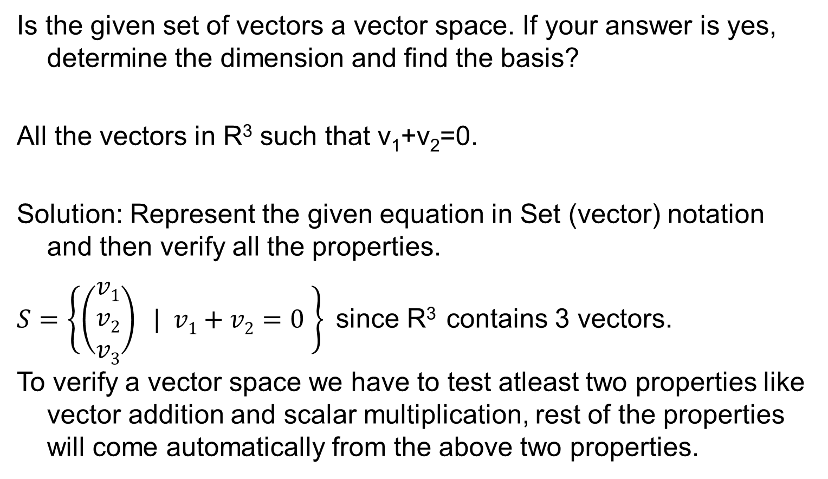
Vector space
Is the given set of vectors a vector space. If your answer is yes, determine the dimension and find the basis?
All the vectors in R³ such that v₁+v₂=0.
Solution: Represent the given equation in Set (vector) notation and then verify all the properties.
$S=\left\{\left(\begin{matrix}v1 \\ v2 \\ v3\end{matrix}\right) | v1+v2=0 \right\}$since R³ contains 3 vectors.
To verify a vector space we have to test atleast two properties like vector addition and scalar multiplication, rest of the properties will come automatically from the above two properties.

Slide 43
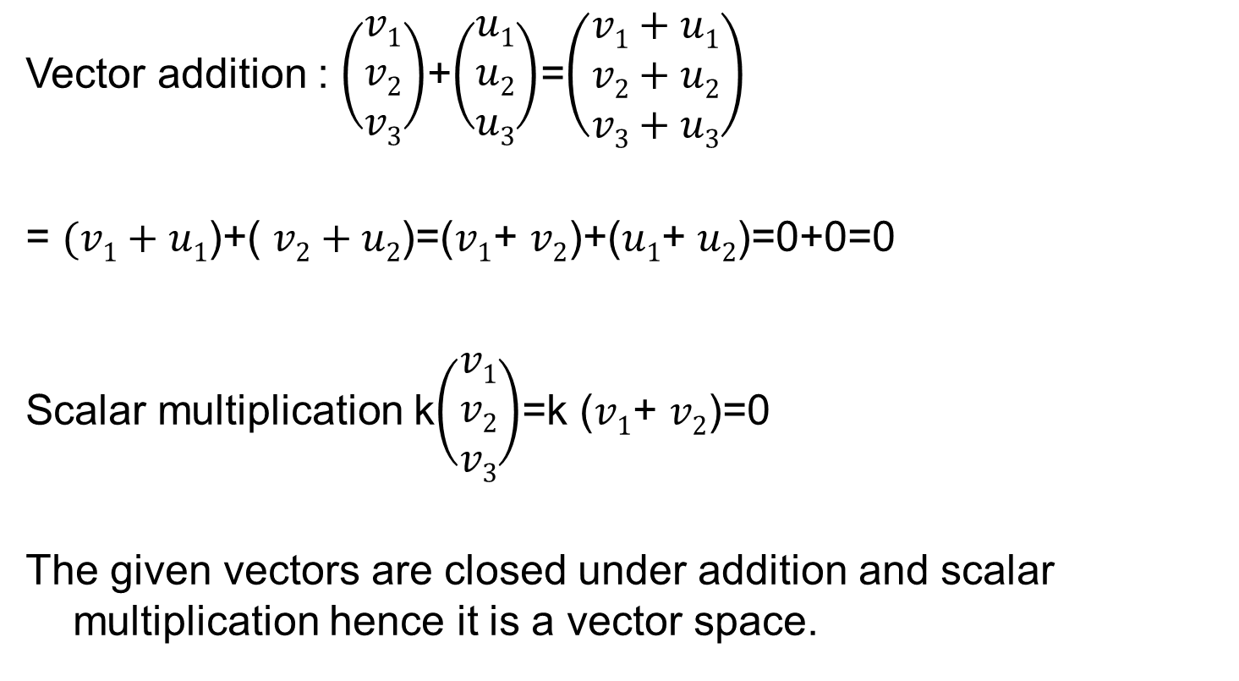
Vector space
Vector addition : $\left(\begin{matrix}v1 \\ v2 \\ v3\end{matrix}\right)$+$\left(\begin{matrix}u1 \\ u2 \\ u3\end{matrix}\right)$=$\left(\begin{matrix}v1+u1 \\ v2+u2 \\ v3+u3\end{matrix}\right)$
= $(v1+u1$)+( $v2+u2$)=($v1$+ $v2$)+($u1$+ $u2$)=0+0=0
Scalar multiplication k$\left(\begin{matrix}v1 \\ v2 \\ v3\end{matrix}\right)$=k ($v1$+ $v2$)=0
The given vectors are closed under addition and scalar multiplication hence it is a vector space.

Slide 44
Vector space
Basis : v₁+v₂=0 for the given condition v₃ is arbitrary;
So v₁ = -v_{2;}
v₂ = s
v₃ = t v₁ = - s, v₂ =s, v₃ = t ; (-s, s, t)= s(-1,1,0)+t(0,0,1)
Basis is (-1,1,0) (0,0,1); since these two vector are independent and any vector in this space can be expressed as a linear combination of (-1,1,0) (0,0,1);
Dimension : 2

Slide 45
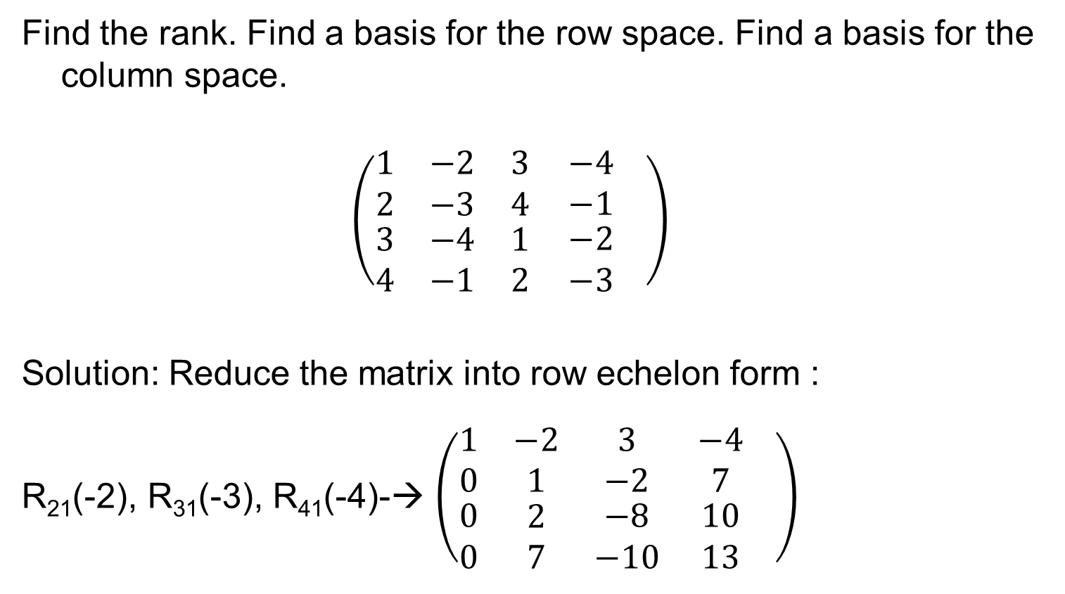
Examples: Rank, basis of row space
Find the rank. Find a basis for the row space. Find a basis for the column space.
$$\left(\begin{matrix}1 & −2 & 3 \\ 2 & −3 & 4 \\ \begin{aligned}3 \\ 4\end{aligned} & \begin{aligned}−4 \\ −1\end{aligned} & \begin{aligned}1 \\ 2\end{aligned}\end{matrix} \begin{matrix}−4 \\ −1 \\ \begin{aligned}−2 \\ −3\end{aligned}\end{matrix} \right)$$
Solution: Reduce the matrix into row echelon form :
R₂₁(-2), R₃₁(-3), R₄₁(-4)-→ $\left(\begin{matrix}1 & −2 & 3 \\ 0 & 1 & −2 \\ \begin{aligned}0 \\ 0\end{aligned} & \begin{aligned}2 \\ 7\end{aligned} & \begin{aligned}−8 \\ −10\end{aligned}\end{matrix} \begin{matrix}−4 \\ 7 \\ \begin{aligned}10 \\ 13\end{aligned}\end{matrix} \right)$

Slide 46
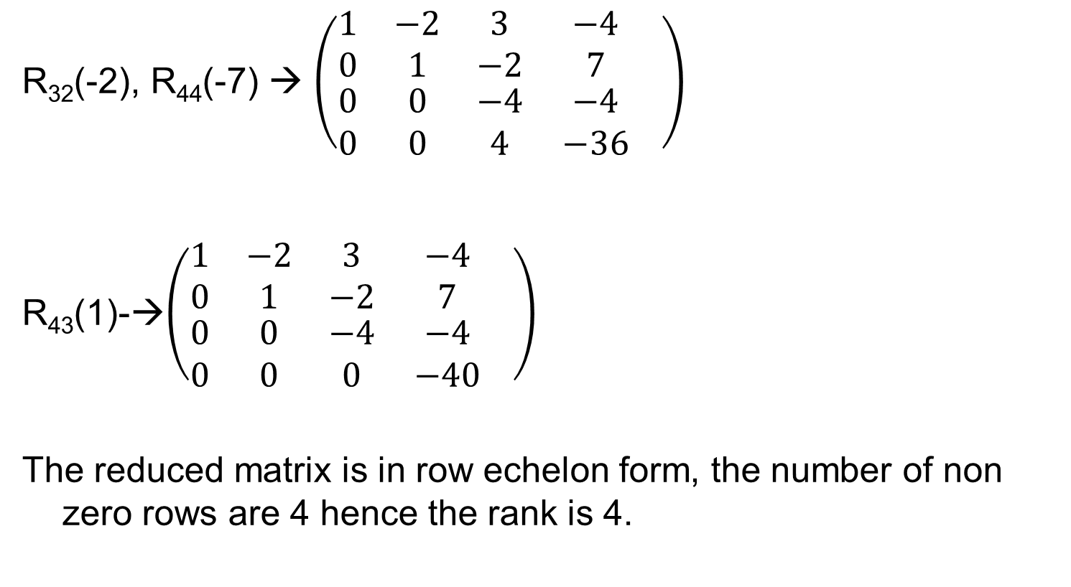
Cont..
R₃₂(-2), R₄₄(-7) → $\left(\begin{matrix}1 & −2 & 3 \\ 0 & 1 & −2 \\ \begin{aligned}0 \\ 0\end{aligned} & \begin{aligned}0 \\ 0\end{aligned} & \begin{aligned}−4 \\ 4\end{aligned}\end{matrix} \begin{matrix}−4 \\ 7 \\ \begin{aligned}−4 \\ −36\end{aligned}\end{matrix} \right)$
R₄₃(1)-→$\left(\begin{matrix}1 & −2 & 3 \\ 0 & 1 & −2 \\ \begin{aligned}0 \\ 0\end{aligned} & \begin{aligned}0 \\ 0\end{aligned} & \begin{aligned}−4 \\ 0\end{aligned}\end{matrix} \begin{matrix}−4 \\ 7 \\ \begin{aligned}−4 \\ −40\end{aligned}\end{matrix} \right)$
The reduced matrix is in row echelon form, the number of non zero rows are 4 hence the rank is 4.

Slide 47
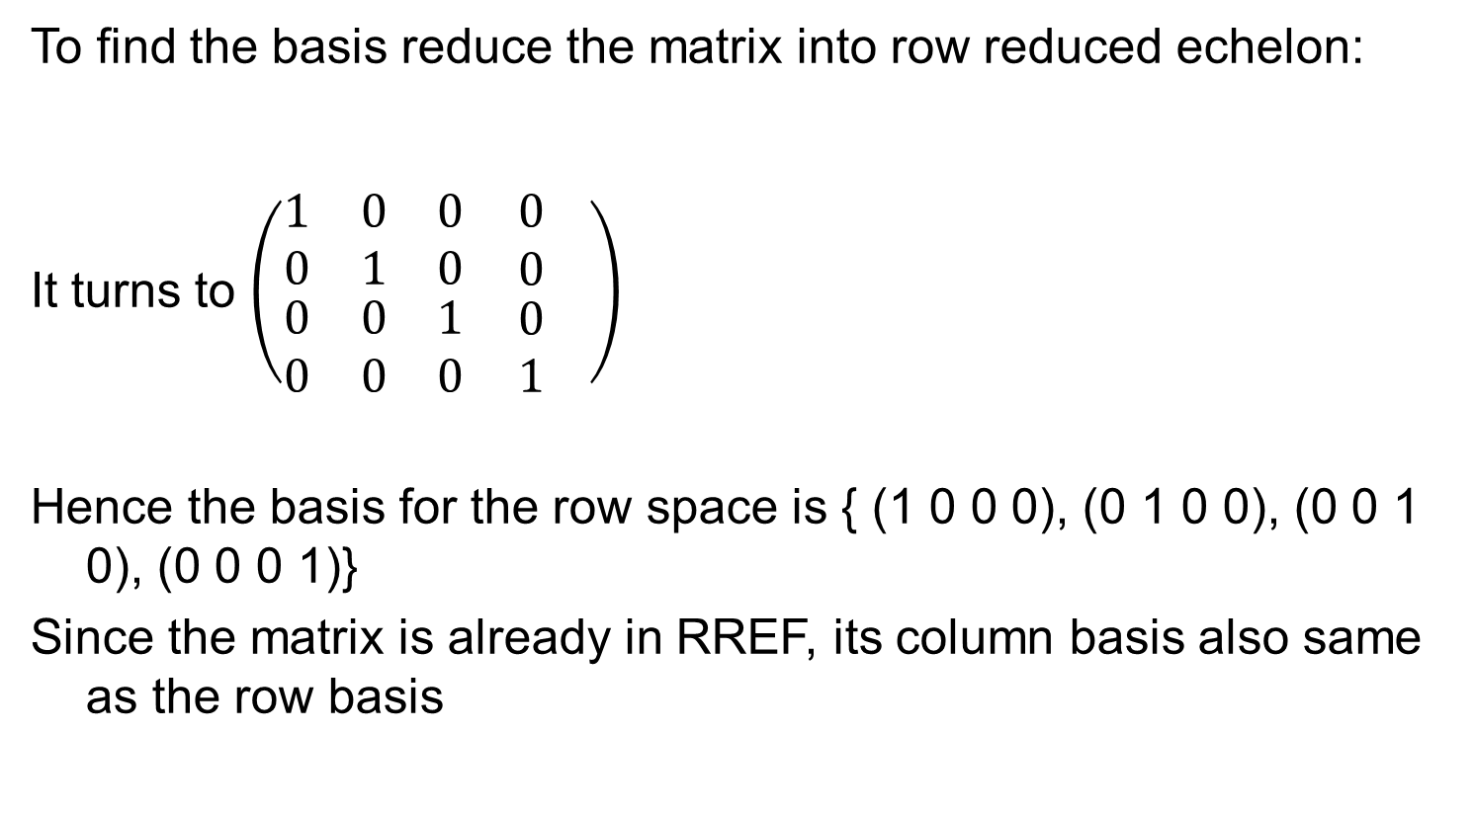
Problem
To find the basis reduce the matrix into row reduced echelon:
It turns to $\left(\begin{matrix}1 & 0 & 0 \\ 0 & 1 & 0 \\ \begin{aligned}0 \\ 0\end{aligned} & \begin{aligned}0 \\ 0\end{aligned} & \begin{aligned}1 \\ 0\end{aligned}\end{matrix} \begin{matrix}0 \\ 0 \\ \begin{aligned}0 \\ 1\end{aligned}\end{matrix} \right)$
Hence the basis for the row space is { (1 0 0 0), (0 1 0 0), (0 0 1 0), (0 0 0 1)}
Since the matrix is already in RREF, its column basis also same as the row basis

Slide 48
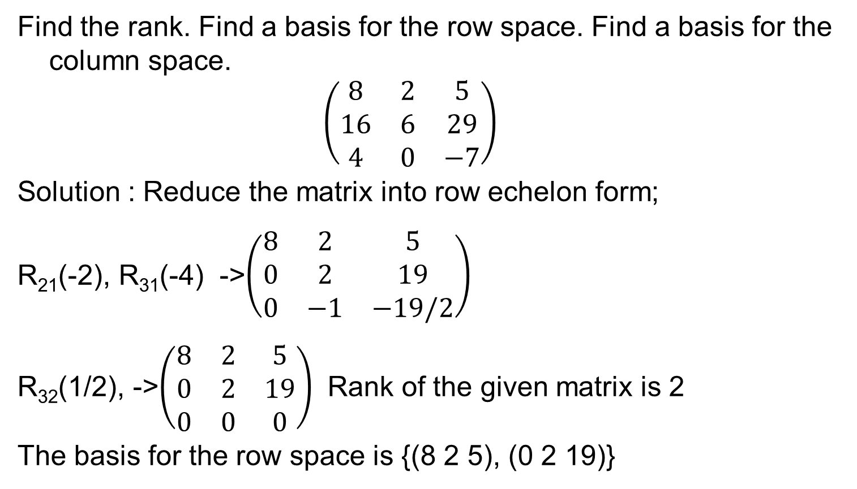
Problem
Find the rank. Find a basis for the row space. Find a basis for the column space.
$$\left(\begin{matrix}8 & 2 & 5 \\ 16 & 6 & 29 \\ 4 & 0 & −7\end{matrix}\right)$$
Solution : Reduce the matrix into row echelon form;
R₂₁(-2), R₃₁(-4) ->$\left(\begin{matrix}8 & 2 & 5 \\ 0 & 2 & 19 \\ 0 & −1 & −19/2\end{matrix}\right)$
R₃₂(1/2), ->$\left(\begin{matrix}8 & 2 & 5 \\ 0 & 2 & 19 \\ 0 & 0 & 0\end{matrix}\right)$ Rank of the given matrix is 2
The basis for the row space is {(8 2 5), (0 2 19)}

Slide 49
Cont..
Because we have only performed linear operations on rows, the non-zero rows in the reduced row echelon form of the matrix comprise a Basis for the Row Space of the matrix. (Note that this is not true of the Column Space; the Column Space certainly changes as you perform row operations.)

Slide 50
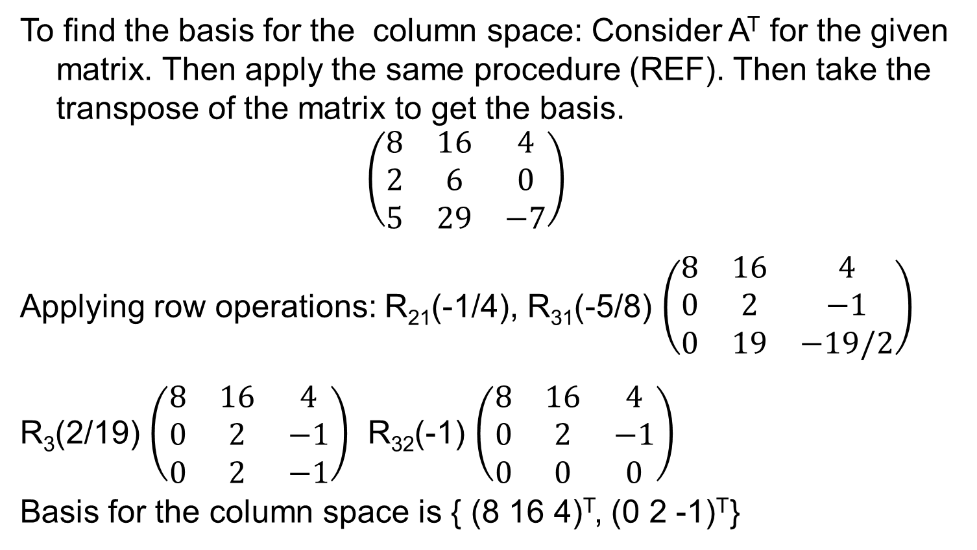
Problem
To find the basis for the column space: Consider A^{T} for the given matrix. Then apply the same procedure (REF). Then take the transpose of the matrix to get the basis.
$$\left(\begin{matrix}8 & 16 & 4 \\ 2 & 6 & 0 \\ 5 & 29 & −7\end{matrix}\right)$$
Applying row operations: R₂₁(-1/4), R₃₁(-5/8) $\left(\begin{matrix}8 & 16 & 4 \\ 0 & 2 & −1 \\ 0 & 19 & −19/2\end{matrix}\right)$
R₃(2/19) $\left(\begin{matrix}8 & 16 & 4 \\ 0 & 2 & −1 \\ 0 & 2 & −1\end{matrix}\right)$ R₃₂(-1) $\left(\begin{matrix}8 & 16 & 4 \\ 0 & 2 & −1 \\ 0 & 0 & 0\end{matrix}\right)$
Basis for the column space is { (8 16 4)^{T}, (0 2 -1)^{T}}

Slide 51
Fundamental theorem for linear systems

Slide 52
Theorem

Slide 54
Theorem

Slide 55
Theorem

